Slide 1

Jim Peregord, Venu Palvai Element Fleet Management
Building a Pluggable Analytics Stack with Cassandra as the Foundation

Slide 2
1 | Background on Element Fleet Management
2 | Key Use Cases Supported
3 | Architecture
4 | Our Journey
5 | Lessons Learned

Slide 3


A Little About Us
Jim Peregord
Venu Palvai
VP – Analytics, BI, Data Mgt
jperegord@elementcorp.com
Lead Architect
vpalvai@elementcorp.com

Slide 4
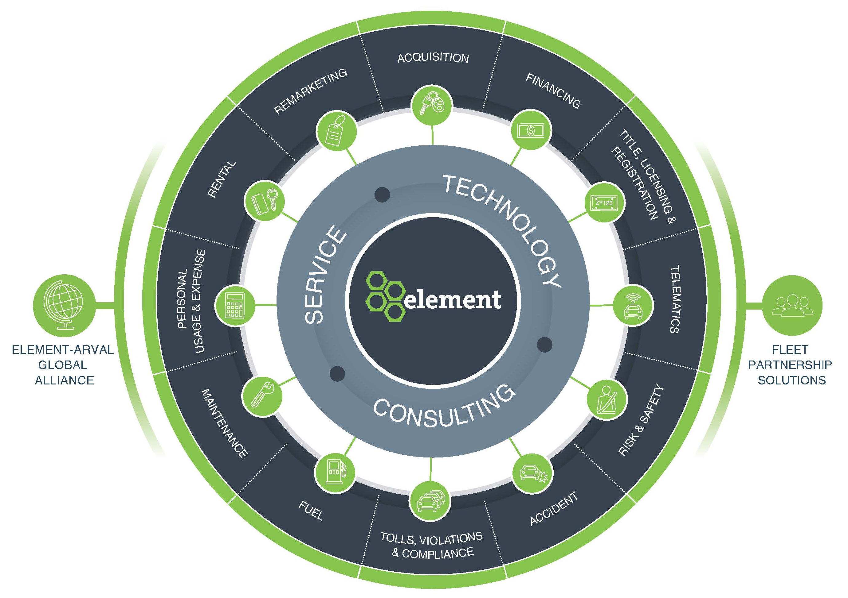
Background on Element Fleet Management
Full lifecycle of fleet management services
Maximize customer
ROI on fleet assets via
data and advanced analytics
2 billion rows of data and growing
1+ million vehicles managed
2,600 employees
Data consolidation and advanced analytics services
$18 billion in total finance assets

Slide 5
Greenfield Opportunity to Build Analytics Platform
Element acquired GE Fleet Management September 1, 2015
Now the largest publicly held Fleet Management company in world
Pre-acquisition Element had limited data warehouse and Big Data tech
Greenfield Opportunity to build next gen BI and Advanced Analytics platform
High-level Options Considered
#1 – Build a separate data warehouse and Big Data/Advanced Analytics platform
#2 – Build a single, unified architecture that supports both
Our Decision
#2 – Build a single, unified platform using DataStax

Slide 6
Key Use Cases Supported on New Platform
High availability out of the box
Linear and elastic scalability
High concurrency and low latency
Real-time ingestion of data streams: Vehicle (location, diagnostics), weather, traffic
Expose data and analytics via RESTful APIs
Advanced Analytics (Predictive, Prescriptive, Streaming)
Data warehouse and traditional reporting

Slide 7
Architecture

Slide 8


Advanced Analytics Hardware Architecture
Purpose-Built Hardware for Advanced Analytics
NUMA/NVME Hardware is not commodity – it is highly specialized for very high performance. Tens of millions of IOPs.
Architected to scale 10x or even 100x current capacity – A must for Telematics and IOT data.
H/W Specs – 256GB, 4 X 2 TB SSD, dedicated C*/Spark instance per SSD
Active-Active clustering means very high availability
C* / Spark / SOLR / FiloDB / DSE Graph + NUMA – High performance analytics platform
Cassandra + Spark
32 nodes
Cassandra + SOLR
8 nodes

Slide 9




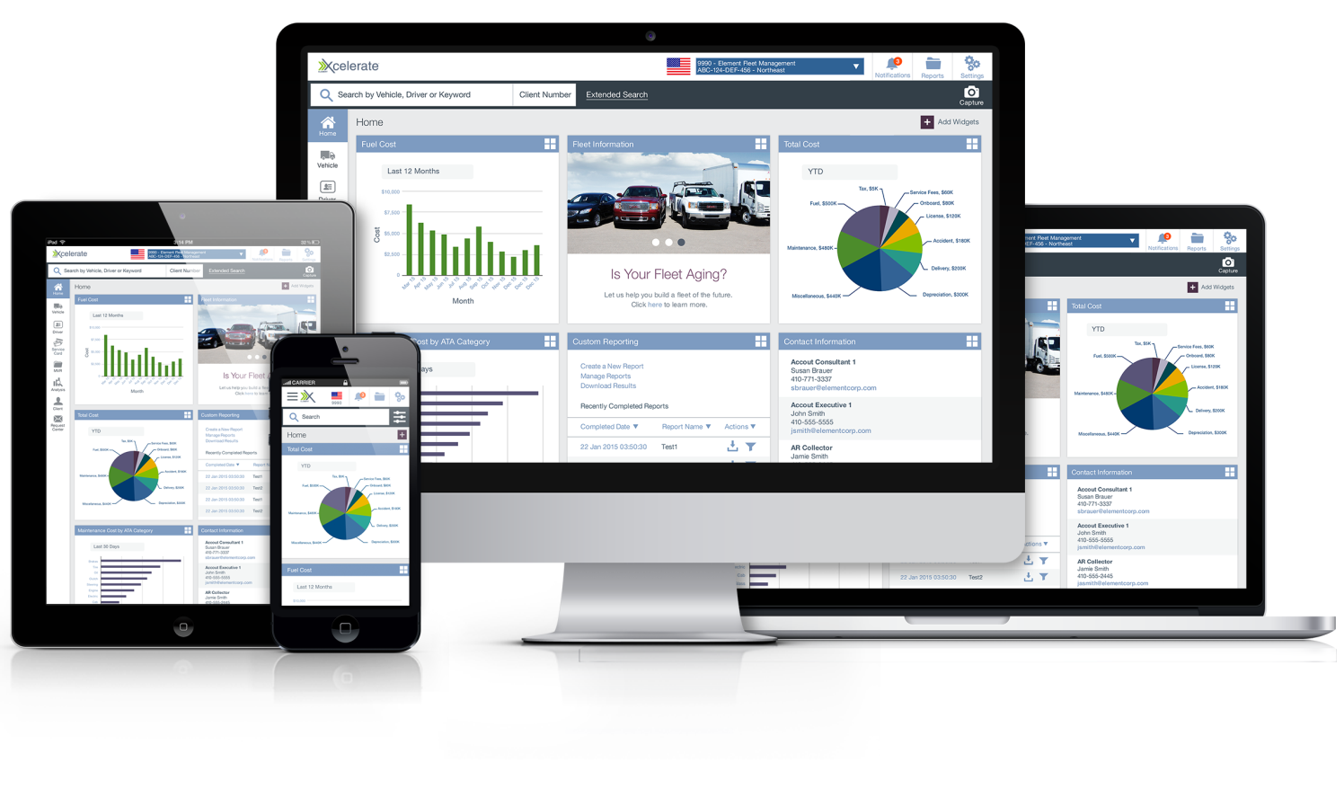





Analytics Logical Architecture
Thrift Server
Spark SQL
Job Server
RESTful
Packages
(PySpark)
MLlib
Events
Streaming
Sources
Amazon SQS
Kafka
External
Internal
filoDB
Batch
Sources
Consumers

Slide 10









Pluggable Architecture - Overview
FiloDB
Columnar Data,
Fast Reads
Spark
SQL, Streaming
Analytics, pySpark
Lucene
Search, Custom
Dictionaries
DSE Graph
Graph-based
Analytics
Future Tools
TBD
Element’s pluggable Analytics stack gives us the ability to plug into multiple analytics tools and choose the right tool depending on the questions we are asking. This gives us the ability to add new analytics capabilities on top of Cassandra as they become available.
10

Slide 11

Pluggable Architecture - FiloDB
FiloDB uses Cassandra for storage and Spark for computation
Optimized for:
Low latency queries and streaming
Interactive ad-hoc analysis on Big Data
Complex analytics and machine learning
Efficient Columnar Storage (20-40X less storage)
All queries are distributed and run in parallel in Spark
Integrates with existing BI tools via JDBC/ODBC
Horizontally scalable, fault tolerant
Future enhancements include Geo Spatial Analysis
FiloDB
Columnar Data,
Fast Reads
Recent blog post by Evan Chan, renowned C* / Spark Expert
www.planetcassandra.org/blog/achieving-sub-second-sql-joins-and-building-a-data-warehouse-using-spark-cassandra-and-filodb

Slide 12
Pluggable Architecture – Apache Spark
Spark
SQL
Spark
Streaming
Spark
MLlib
Spark
SQL, Streaming
Analytics
In-memory, fast SQL processing
Easily blend data from multiple sources
Connect to BI tools
Ingest streaming data sources like telematics, weather, engine diagnostics, etc.
Library of machine learning algorithms for advanced analytics

Slide 13

Pluggable Architecture – Lucene / SOLR
Powerful search algorithms
Geospatial indexing and geo-queries
Custom dictionaries
Efficient metric calculations
Lucene
Search, Custom
Dictionaries

Slide 14

Pluggable Architecture – DSE Enterprise Graph
Graph databases store data as a network of relationships
Provides optimized analytics for any data where relationships are most important
Can improve query/analytics performance 1000X
Example use cases:
IOT time series on streaming data
Vehicle routing
Visualize clusters of well/under performing assets
Recommend optimal actions
Fraud detection
DSE Graph
Graph Data
Analytics

Slide 15
Pluggable Architecture – Cassandra
High performance NoSQL database
Flexible schema allows new data attributes to be easily added
Peer-to-Peer, distributed architecture results in no single point of failure – different than traditional databases
Elastic scalability to add more servers as workload increases

Slide 16






What our Platform Means to Customers
INFRASTRUCTURE IMPROVEMENTS
20x CPU Speed
10x Memory
70x Disk Performance
ALL RUNNING ON
Cassandra database framework has been adopted by companies running some of the world’s largest and most sophisticated real-time analytics
Data
Insights
Action
Maintenance history
Fuel purchases
Miles driven
GPS location
Points of Interest
Weather
Traffic
Online repair reviews
Fuel price geo-indexing
Predict Operating Costs
Fraud Detection
Business Rule Exceptions
Accident Predictors
Optimal Replacement
High risk DTC codes
Repair sentiment analysis
Vehicle Replacement Schedule
Fraud actions
Safe driving interventions
Non-standard maintenance schedule
Recommend fueling and maintenance facilities
Sifting through the data “noise” must be as fast as possible in order to create actionable recommendations

Slide 17
Our Journey

Slide 18
Journey to Build a Unified BI and Analytics Platform
Creating flexible data models that work for both BI and analytics
Achieving high concurrency and low latency required for enterprise reporting platforms
Optimizing software installation and configuration for performance
Workload management

Slide 19
Dimensional Modeling for BI and Analytics
BI Tools are designed to work with dimensional models
Dimensional models are proven and easy to understand and model
Dimensional models are flexible, can answer many questions
OLAP use cases require slicing and dicing data across multiple dimensions
JOIN capability is critical for achieving data models that can answer various questions
Dim
Dim
Fact
Dim
Dim

Slide 20
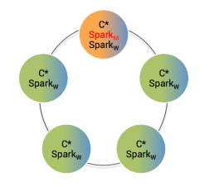
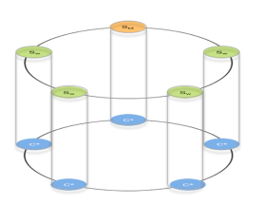
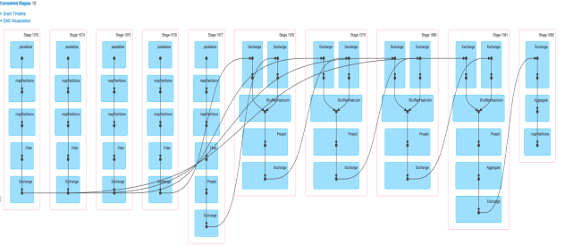
Limitations of Spark SQL
Cassandra + Spark cluster provides JOIN functionality
Spark SQL is not able to pass filters applied on one table to another table if both tables are joined on filtering columns.
Predicate pushdowns are not working for Outer JOIN relationship
Pushing predicates to Cassandra/Data source guarantees better performance
Sample DAG plan for a JOIN SQL with 5 tables
SQL Example:
Select c.customer_id, c.customer_name , i.invoice_amount
From customer c,invoice i
Where c.customer_id = i.customer_id
And c.customer_id = 123;
Spark splits above SQL into
Select c.customer_id, c.customer_name from customer c
Where c.customer_id = 123;
Select i.customer_id, invoice_amount
From invoice i;

Slide 21
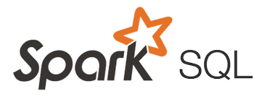
Custom Thrift Server to Optimize SQL Statements
Adds predicates to joining tables based on matching join columns
Converts IN conditions to = conditions whenever IN List has only one value
Adds IN predicate on partition column based on the range predicates supplied on non-partition key columns
Example
Select c.customer_id, c.customer_name , i.invoice_amount
From customer c,
invoice i
Where c.customer_id = i.customer_id
And c.customer_id IN (123)
Select c.customer_id, c.customer_name , i.invoice_amount
From customer c,
invoice i
Where c.customer_id = i.customer_id
And c.customer_id = 123
And i.customer_id = 123
Custom
Thrift Server
Spark thrift server with
Custom Hive Context
Inspect Logical Plan
Modify Logical Plan
(if needed)
Submit plan
for
Execution

Slide 22
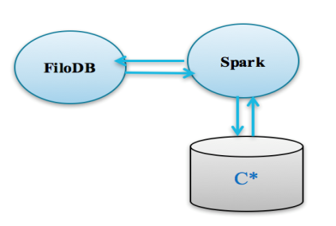
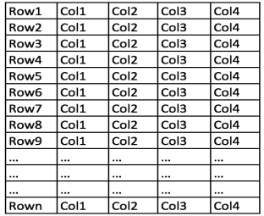
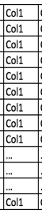
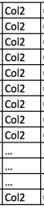
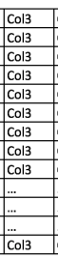
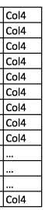
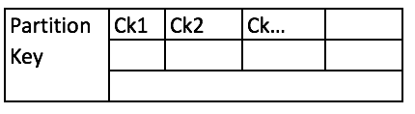
FiloDB
Rows of data
Cassandra 2.1 has several restrictions on predicate pushdowns
FiloDB is a true columnar store
Provides ~20 – 30 times compression over Cassandra
Very efficient for single and multiple partition scans
Partial Predicate Pushdown support
Provides ~20 - 30 times better read performance over straight Cassandra
Get converted to compressed columnar chunks
Ck1
Ck2
Cassandra Storage of FiloDB data

Slide 23
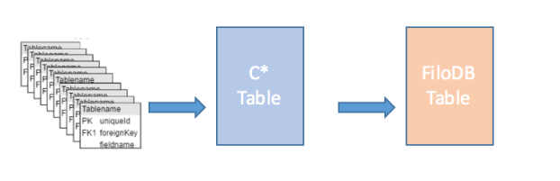
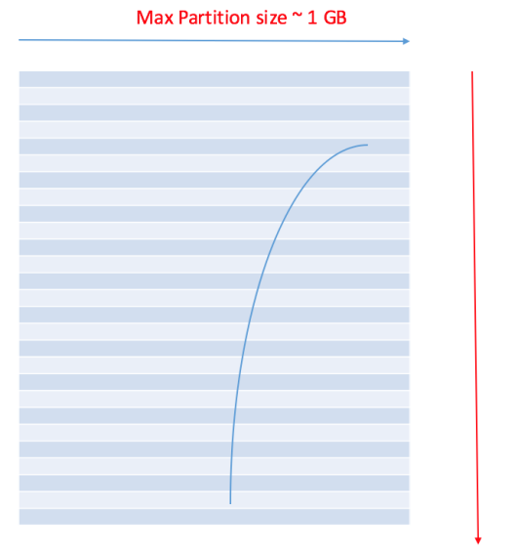
Dimensional Data Modeling for Cassandra + Spark
Simple STAR schema models as much as possible (eliminate snow flakes, outer joins etc)
De-normalized dimensions, facts (avoid duplicating dimensions into facts)
Minimize number of tables involved in joins
Common partitioning strategy across dimensions and facts (easy predicate handling)
Limiting max partition sizes to ~1 GB
Reduce number of partitions for efficient Spark execution, limit partition sizes for efficient Cassandra read operations

Slide 24

Example: ETL Incremental Load Strategy
ODS
ADS
FILODB
SPIN
THRIFT
RELOAD
INCREMENTAL
INCREMENTAL
SPARK
JDBC
SSRS
Power BI
C*
C*
CASSANDRA/SPARK
ETL - TALEND
ODS is truncate/load daily.
ADS is complete replica of the source system. Incremental ETL strategy.
ODS tables are used to load FiloDB table (incremental) using Spark Jobs.

Slide 25
Results & Opportunities
Successfully completed 300 concurrent user load test from Business Objects
<1 second response from thrift servers for 90% of queries
Average of 50 columns & 50 - 500k rows returned
Single partition and multi-partition scans, Joins involving 5-10 FiloDB tables per each query
Opportunities
Limitations on the maximum result size that can be collected using Spark SQL
Limitations on the total concurrent result size requested from Spark thrift server
These are tunable limitations

Slide 26
Lessons Learned
Limitations of Cassandra for Fast Analytics, may require custom development
Have a strategy to handle growth of Cassandra partitions
Throttle read & write work loads for the size of the cluster
Tombstone management
Pick right ETL tool for the job.
Turn off NUMAD service
Lack of monitoring tools on Spark
Spark’s lazy evaluation, makes debugging very difficult

Slide 27
Questions?

